Slide 1
Ekonometria przestrzenna
Izabela Reszka, Piotr Wiśniewski, Klaudia Woźniak

Slide 2
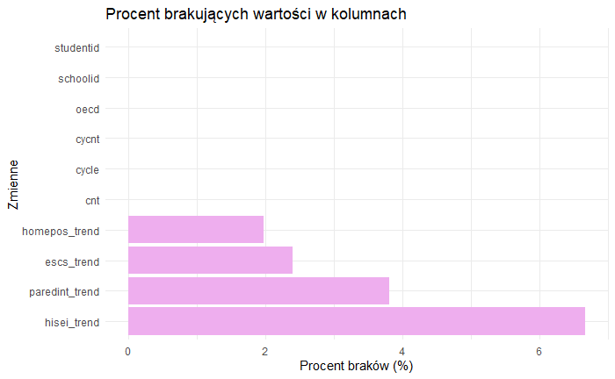
Zaprojektowanie prezentacji w powerpoint - dodanie punktu 2,3,4,5 (podpunkt a,b)
—

Slide 3
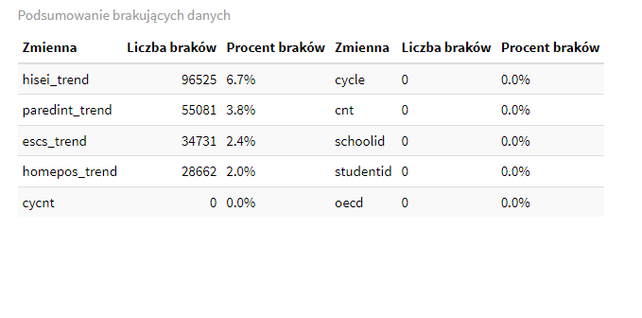

Slide 4
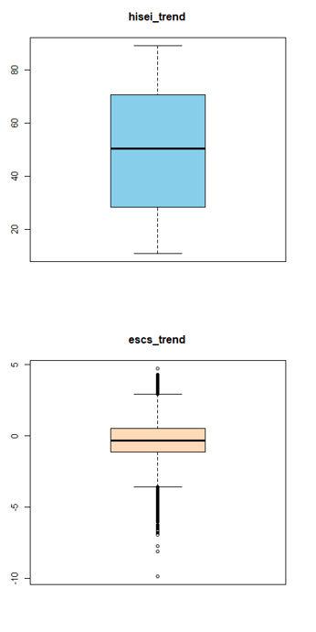
PRODUCT OVERVIEW

Slide 5
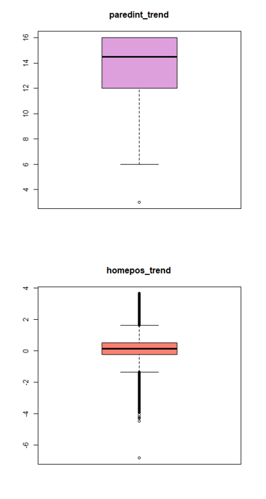
PRODUCT OVERVIEW

Slide 6
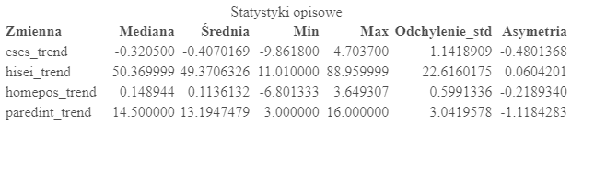
PRODUCT OVERVIEW

Slide 7
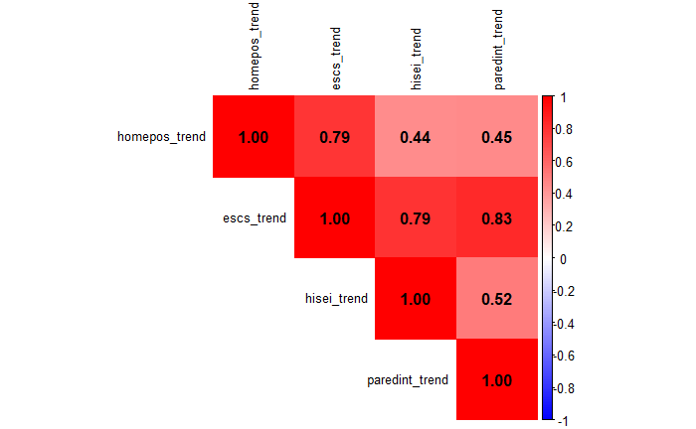
PRODUCT OVERVIEW

Slide 8
BUSINESS MODEL
ABSTRACT
We based our research on market trends and social media
DESIGN
We believe people need more products specifically dedicated to this niche market
RESEARCH
Minimalist and easy to use

Slide 9
MARKET OVERVIEW
$3 Billion
$1 Billion
$2 Billion
Freedom to invent
Selectively inclusive market
Serviceable available market
Opportunity to build
Fully inclusive market
Total addressable market
Few competitors
Specifically targeted market
Serviceable obtainable market

Slide 10
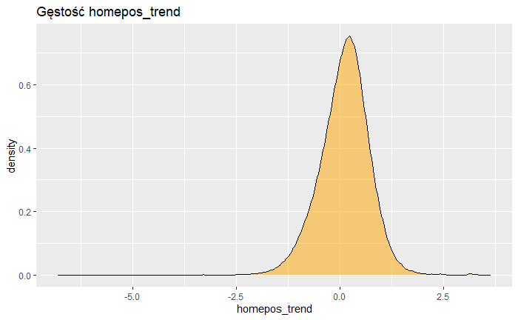
MARKET OVERVIEW

Slide 11
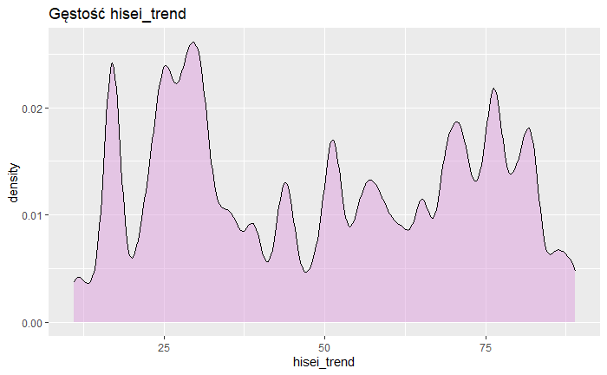
MARKET OVERVIEW

Slide 12
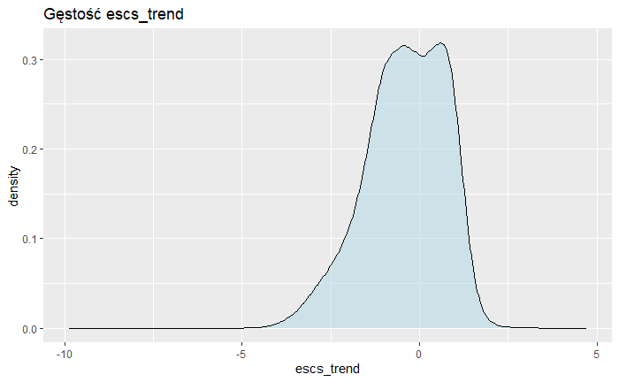
MARKET OVERVIEW

Slide 13
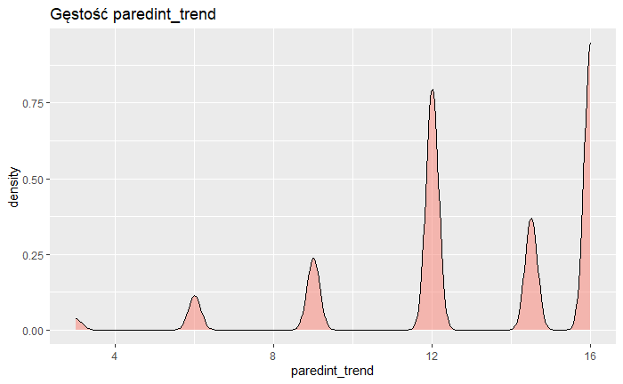
MARKET OVERVIEW

Slide 14
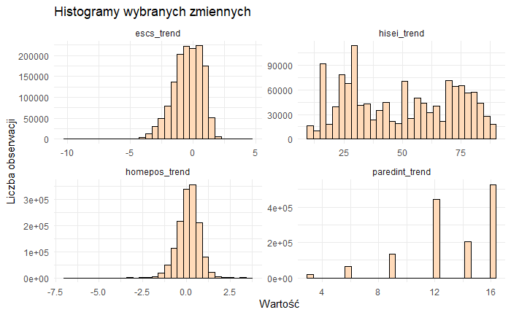
MARKET OVERVIEW

Slide 15
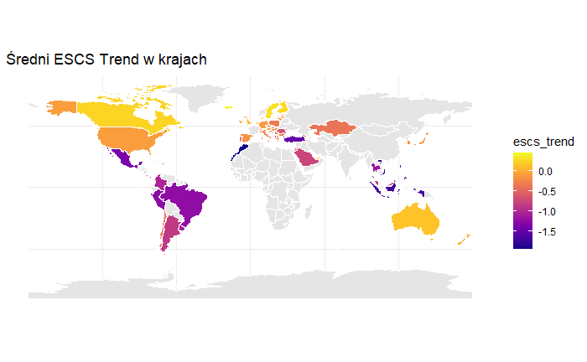
MARKET OVERVIEW

Slide 16
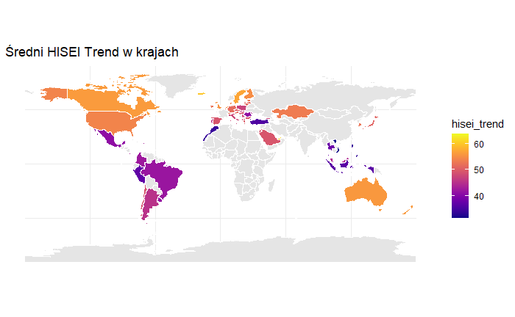
MARKET OVERVIEW

Slide 17
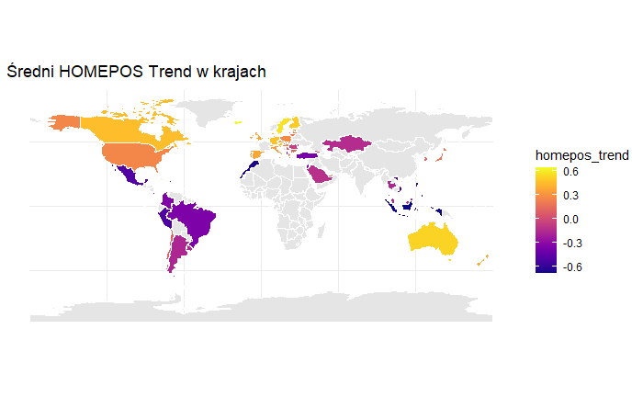
MARKET OVERVIEW

Slide 18
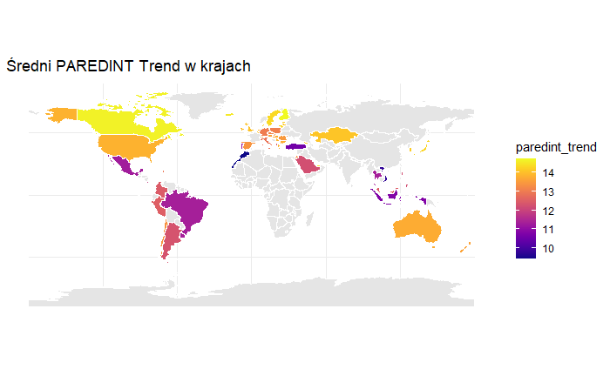
MARKET OVERVIEW

